Slide 1
GROUP 6 CAPSTONE PROJECT
PACH AND POSEY BUSINESS ANALYSIS, VISUALIZATION AND RECOMMENDATION

Slide 2
THE QUESTIONS
Which region generates the highest revenue?
What is the total sales revenue generated by each sales rep?
Which customers have placed the highest number of orders
What is the conversion rate from web events to actual orders?
What is the total revenue generated by Parch and Posey
What is the average order value (AOV) per customer?
Who are the repeat customers?
Which acquisition channel brings in the highest number of customers?
What is the Monthly trend of total sales
How does revenue vary by day of the week?

Slide 3
THE QUESTIONS VISUALIZED
1. 1. What is the revenue per region?
2. Which customers have placed the highest number of orders?
3. What is the Monthly trend of total sales?
4. How are the web-events attended by customers?
5. What is the average order value (AOV) per customer?
6. How does revenue vary by day of the week?
7. What is the total revenue generated by Parch and Posey per year?

Slide 4
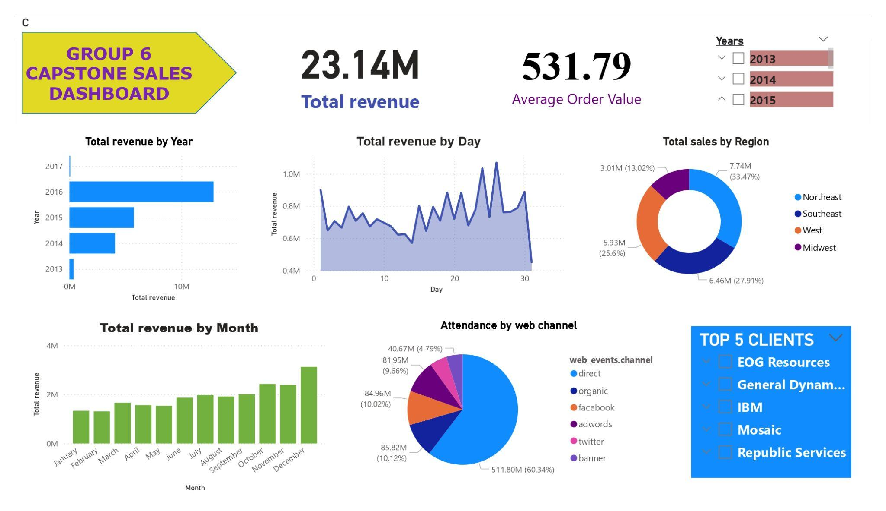
Visualization

Slide 5
Recommendations
There was a massive drop in the sales in the year 2017 owing to a change in suppliers of raw materials, reduction of the marketing budget and reduced customer discounts
Therefore, I recommend;
Reverting to the original raw materials supplier
Increased marketing budget to conduct Marketing campaigns, employ more sales reps and carry out feedback surveys from customers
Incentivize our customers with loyalty rewards and discounts.
Increase our web events ad campaigns
Strengthen our relationship with our highest and frequent customers to ensure customer retention.

Slide 6
Links
Visualization
https://drive.google.com/file/d/1qXVvOCErZSSySWGLc97bd2XLotnvhwwl/view?usp=sharing
Social Media Poster : LinkedIn
https://www.linkedin.com/in/lesley-amimo-850541188/

